Slide 1
Processing of zooplankton samples in the laboratory for results at significant level.
Albert Keim

Slide 2
Zooplankton samples at significant levels
I need samples without artifacts.
Clogging was avoided by using a pump.
Taking a representative subsample remains a problem.
Normal distribution in the subsample?

Slide 3
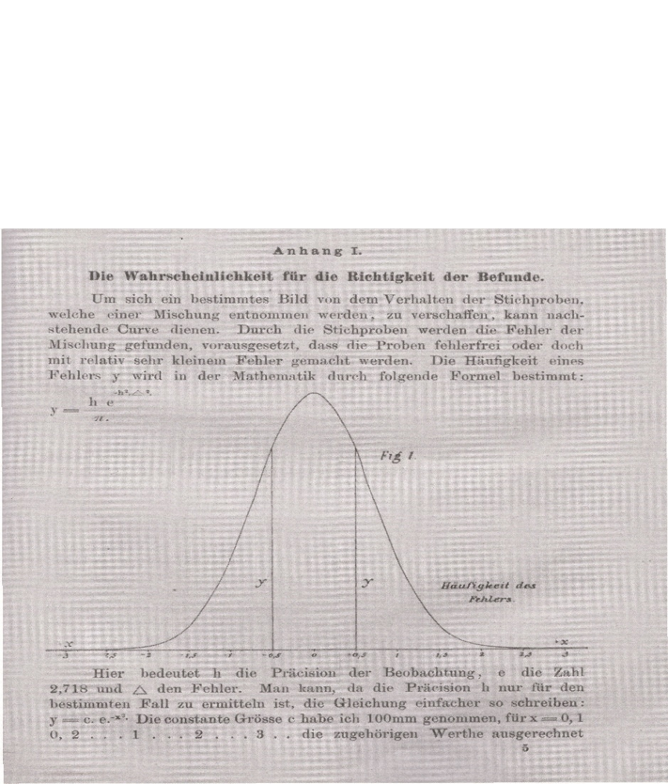
Hensen (1891):
Sorry for bad quality -
Hensen asked for the
Probability for findings
being correct
Gap of many years
Galbraith (1965) used the Length distribution in
Zooplankton studies

Slide 4
Avoidance of artefacts
Twenty years ago, at samples from a mesotrophic lake, I counted the number of
1 ml subsample in a gutter, repeated the counting and calculated for the whole sample.
Now, at samples from an eutrophic lake, that does not work.

Slide 5
A look back at Lake Buchtzig: vertikal migration!
After stocking with 150 kg roach for 8,5 ha lake area

Slide 6
A look back at Lake Buchtzig: normal distribution?
After three years without roach stocking
arithmetic mean: 1036 µ
arithmetic mean: 837 µ

Slide 7
And fish stocking was done again.
maximum value |  |  | 1866,7 | upper bound 5,46
minimum value |  |  | 600 | lower bound 4,24
difference = R |  |  | 1266,7 | mean | 1076 µ
standard deviation |  |  | 272 | number 75
R/s |  |  | 4,657 | within | the | limits
maximum value |  | 1888,9 | upper bound 5,68
minimum value |  | 1022 | Lower bound 4,44
difference = R |  | 866,9 | mean | 1392 µ
standard deviation |  | 246,6 | number 122
R/s |  | 3,5154 | outside | the | limits

Slide 8
Draw the subsample
After stirring the sample, I must be quick to take the subsample.
Sedimentation starts immediately Stich & Maier (2010)
And the segregation of the particles occurs.
Artifact happens.

Slide 9
Comparison of subsamples Eudiaptomus gracilis
22. August 2026; 1-6 m depth. Sample: 200 ml
Results shocking and unbelievable
Subsample | Volume | Number | arithmetic mean (µ)
A | 3 ml | 58 | 1026
B | 3 ml | 24 | 1122
C | 3 ml | 49 | 897
D | 3 ml | 29 | 903

Slide 10
After a sleepless night:
Purchase bovine gelatin
Moisten and heat for liquid state
Stirr in the zooplankton sample
Cooling in refrigerator
Weigh the gelatin as a whole
Cut out a sector and weigh it
Heat the sector in waterbath for liquid state
Identification and measurement under the microscope

Slide 11
8 December 2025, 1-7 m depth, sector 2,7 g, inner part from 51,9 g gelatin. Eudiaptomus gracilis

Slide 12
Test for normal distribution according to
David et al 1954 in Sachs, Angewandte Statistik 1978
max | 1422 µ | upper bounds |  | 5,96
min | 333 µ | lower bounds |  | 4,72
R | 1089 µ |  | R/s | 5,6
Stdev = | 194,6 |  | N = 165
5,6

Slide 13
8 December 2025, 1-7 m depth, sector 2,7 g, outer part from 51,9 g gelatin. Eudiaptomus gracilis

Slide 14
Test for normal distribution, according to David et al 1954 in Sachs, Angewandte Statistik 1978
max | 1599 | 1333
min | 311 | 311
R | 1288 | 1022
Stdev s | 186 | 186
R/s | 6,92 | 5,49
upper bound | 5,96 | 5,96
lower bound | 4,72 | 4,72

Slide 15
8 December 2025, 1-7 m depth, sector 2,7 g, inner part from 51,9 g gelatin. Cyclopoida, Test failed

Slide 16
Test for normal distribution according to
David et al 1954 in Sachs, Angewandte Statistik 1978
max | 1022 µ | upper bounds |  | 6,72
min | 267 µ | lower lbounds |  | 5,49
R | 755 µ |  | R/s = | 4,6
Stdev = | 164,4 | Test failed | n | 371

Slide 17
Work with gelatin on zooplankton is cumbersome
I complained to a friend: I must impede the sedimentation.
Two days later he called me back:
Come over and take along my
magnetic stirrer.

Slide 18
24 January 2026
Just one month after the winter solistice
(25 December)
The daylength is increasing
Some organisms start reproduction
Offspring is visible

Slide 19
24 January 2026, 1-7 m depth, 5 ml from 200 ml, Cyclopoida. Test for normal distribution failed

Slide 20
24 January 2026, 1-7 m Depth, 5 ml from 100 ml,
Cyclopoida, Test for normal distribution positive

Slide 21
24 January 2026, 8-12 m Depth, 5 ml from 100 ml,
Cyclopoida, subsample 1

Slide 22
Test for normal distribution, according to David et al 1954 in Sachs, Angewandte Statistik 1978
Max 1889 upper bounds 6,39
Min 489 lower bounds 4,9
R 1400 n = 194
Stdev 312
R/s 4,48 outside the limits

Slide 23
24 January 2026, 8-12 m Depth, 5 ml from 100 ml,
Cyclopoida, subsample 2

Slide 24
Test for normal distribution, according to David et al 1954 in Sachs, Angewandte Statistik 1978
Max 2000 upper bounds 6,15
Min 422,2 lower bounds 4,9
R 1577,8 n = 275
Stdev 307,76
R/s 5,13

Slide 25
6 April 2026, 3-7 m depth, 2 ml from 200 ml
Daphnia galeata, subsample 1

Slide 26
Test for normal distribution, according to David et al 1954 in Sachs, Angewandte Statistik 1978
max | 2667 | 2667
min | 333 | 667
R | 2334 | 2000
SD s | 458 | 319
R/s | 5,096 | 6,27
upper bound | 6,72 | 6,72
lower bound | 5,49 | 5,49

Slide 27
6 April 2026, 3-7 m depth, 2 ml from 200 ml
Daphnia galeata, subsample 2 and 3

Slide 28
Test for normal distribution, according to David et al 1954 in Sachs, Angewandte Statistik 1978
max | 2267 | 2267
min | 355 | 511
R | 1911 | 1755
SD s | 452,2 | 340,3
R/s | 4,23 | 5,16
Upper bound | 6,72 | 6,72
Lower bound | 5,49 | 5,49

Slide 29
6 April 2026, 3-7 m depth, 2 ml from 200 ml
Daphnia galeata, subsample 3

Slide 30
Test for normal distribution, according to David et al 1954 in Sachs, Angewandte Statistik 1978
max | 2667 | 2667
min | 333 | 667
R | 2334 | 2000
SD s | 458 | 318,6
R/s | 5,09 | 6,28
Upper bound | 6,72 | 6,72
Lower bound | 5,49 | 5,49

Slide 31
Links to records of zooplankton 2025/26
https://p-fraktionen.de/zooplankton-september-2025/
https://p-fraktionen.de/zooplankton-dezember-2025-knielinger-see/
https://p-fraktionen.de/?s=knielinger+see+januar++2026
https://p-fraktionen.de/?s=knielinger+see+april

Slide 32
Exchange
These results are possible due to lively conversations with the fisheries technician Josef Hönig in Bruchsal-Heidelsheim.
In my view, there is a high need for better working methods and tools to achieve results in making predictions.
Planktology in inland waters has long worked with equipment that causes artifacts. I have to criticize the gear.
I think that there is still a lot of work.

Slide 33
Acknowledgements
I thank Jürgen König from the Ettlingen Baths Administration
and Thomas Biletzki from the Karlsruhe Anglers' Association
for their support and for allowing me to publish these results.

Slide 34
Thanks
a lot for your attention.
Albert Keim
Schlittengasse 14, 76646 Bruchsal

